Slide 1
LECTURE 1:
An Introduction to Sociology

Slide 2
TOPICS
What is sociology?
The sociological imagination (aka the sociological perspective)
Social Institution – an important sociological concept
The 3 main theoretical perspectives in sociology: functionalism, conflict, symbolic interactionism

Slide 3
What Is Sociology?
Sociology: is the systematic study of society and social interaction
  the systematic study of the relationship between individuals and society
Sociological Perspective (also called the “sociological imagination”)
  perspective from which one sees and understands the connections between individuals and the broader social contexts in which they live

Slide 4
Why Study Sociology?
Sociologists study societies and social interactions to develop theories about:
  How group life shapes individual behavior and beliefs
  How individuals affect group life
Sociology can help to:
  Better understand ourselves and our social world
  Understand how society shapes our behavior and we shape society
  Promote understanding and tolerance
  Overcome human biases
    E.g. media induced bias
  “make the familiar strange”

Slide 5
Why Study Sociology?
Goes beyond common sense:
  Many people will say “Sociology is easy, most of it is common sense.”
  However, this is a mistake because sociology goes beyond common sense … to explaining often large-scale, complex phenomena.
  Ex: Lazarsfeld (1949): Study of American Soldier during WW2

Slide 7
Why Study Sociology?
Notes:
Lazarsfeld, P. F. (1949). "the american soldier"-AN EXPOSITORY REVIEW. The Public Opinion Quarterly, 13, 377.

Slide 8
Why Study Sociology?

Slide 9
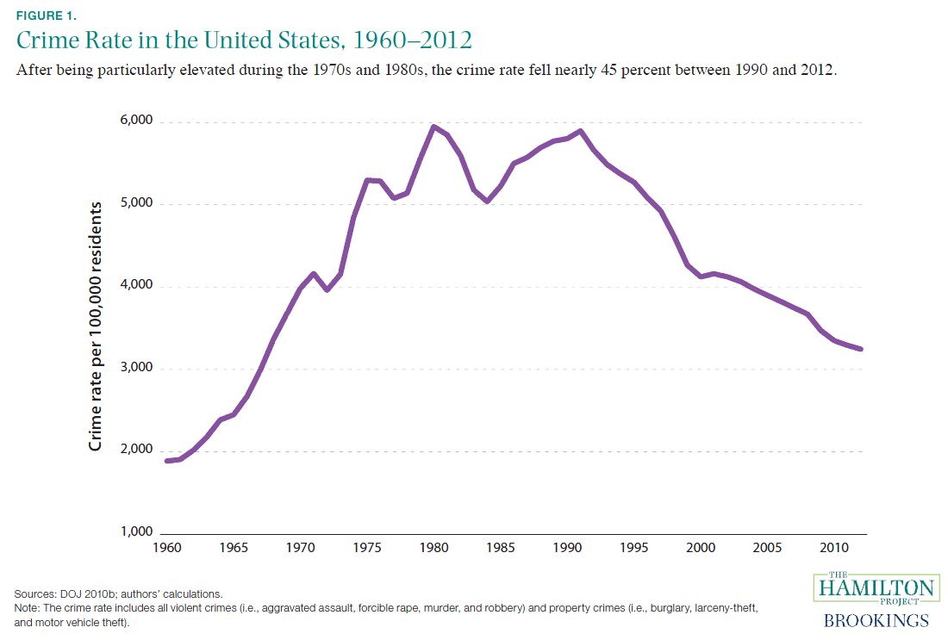
Why Study Sociology?

Slide 10
Routine Activities Theory
Crime most likely to occur when
  Motivated offender
    rapid social change, distrust, social inequality
    war on drugs, police power
  Suitable target
    Visibility, Inertia, Value, Accessibility
      Consumerism
      Suburbanization
      Car and TV ownership
  Lack of formal and informal social control

Slide 11
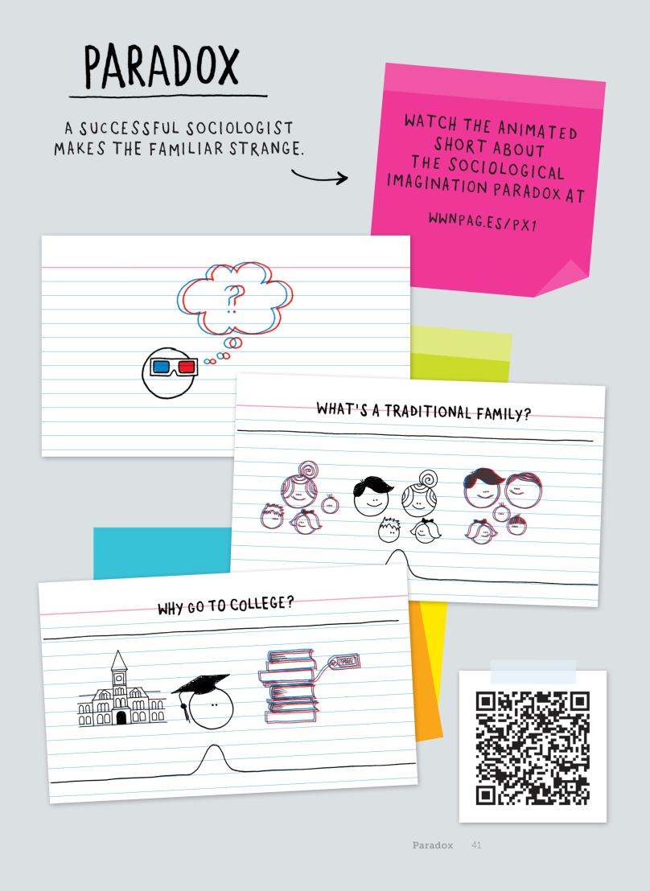
Paradox
A successful sociologist makes the familiar strange
Click here to watch the paradox animation: http://wwnpag.es/PX1
  Or here: https://www.youtube.com/watch?v=OBt95kwNV04
(From You May Ask Yourself textbook)

Slide 12
Group Exercise: Thinking Sociologically
Pair up and discuss examples of how:
  … the social conditions of a group/community/society may contribute to the likelihood that an individual would commit suicide
    In other words, what group/community/societal factors may account for a high suicide rate in one group/community/society vs. a low rate in another???
  … an individual committing suicide could affect the behavior or social conditions of the larger group/community/society?
Then we will discuss some examples with the class

Slide 13
Possible reasons
Relative deprivation
Cultural values and expectations
  High expectation and competitiveness
  Cultural decline
Rapid social change or uncertainty
Being a man:
  Lack of support group

Slide 14
How Much Do You Know About Suicide?
More people die by suicide than homicide
Major public health concern
Over 40000 died by it in Us (CDC)
  2016: 44,965 suicides, up from 42,773 in 2014

Slide 15
Another Example
Serial Killers
  Usually resort to psychiatric explanations
  Sociological:
    Aspects of culture and social structure vary by state account for variations in male serial killer activity
    Factors:

Slide 16
TOPICS
What is sociology?
The sociological imagination (aka the sociological perspective)
Social Institution – an important sociological concept
The 3 main theoretical perspectives in sociology: functionalism, conflict, symbolic interactionism

Slide 17
THE SOCIOLOGICAL PERSPECTIVE
Sociology vs. Psychology
  Sociology focuses on the influences of social forces on human life
  Psychology studies individuals and focuses on similarities and differences between individuals
  Example: Suicide

Slide 18
THE SOCIOLOGICAL PERSPECTIVE
“The first fruit of the sociological imagination is that the individual can understand personal experience only by becoming aware of those of all individuals in similar circumstances. In many ways this is a terrible lesson; in many ways a significant one.”
      C. Wright Mills

Slide 19
Sociological Perspective or Sociological Imagination
Concept proposed by C. W. Mills in 1959
Sociological imagination is the ability to:
  See the relationship between individual experiences and the larger society (how social forces shape individual action)
  Discover the general in the specific
  Make personal troubles public issues

Slide 20
Example: Suicide
As a Personal Trouble:
  Many people consider suicide to be the
  result of personal problems … an isolated act … main “cause” is “mental illness”
As a Public Issue:
  Sociologist Emile Durkheim related suicide to the cohesiveness in society instead of just viewing it as an isolated act that could only be understood by studying individual personalities or inherited tendencies.

Slide 21
Personal Troubles and Public Issues
Example: Unemployment | PERSONAL TROUBLES | PUBLIC ISSUES
FOCUS: | Personal needs, problems, difficulties | Outside the individual
CAUSE: | Individual shortcomings | Flaws or breakdown in institutional arrangements
EXAMPLES OF CAUSES: | Lack of motivation Bad attitude Flawed character Weak skills | Unemployment resulting from profit-making strategies that reduce labor costs through downsizing, automation, outsourcing, and layoffs
RESOLUTION: | Change individual shortcomings | Change institutional structure
CHANGE STRATEGIES: | Seek therapy Find new friends Try harder, etc. | Institute tax incentives encouraging specific behaviors. Change or write new laws, etc.

Slide 22
Personal Troubles and Public Issues
GROUP EXERCISE:
Get together and discuss examples in your own lives:
  Think of a personal issue and then think of how certain public issues are related to it.
  Then we will discuss it with the class

Slide 23
TOPICS
What is sociology?
The sociological imagination (aka the sociological perspective)
Social Institution – an important sociological concept
The 3 main theoretical perspectives in sociology: functionalism, conflict, symbolic interactionism

Slide 24
Social Institution: an important sociological concept
Social Institution: “a complex group of interdependent positions that, together, perform a social role and reproduce themselves over time.”
  Ex: economy, family, the media, education, the state (government), healthcare
  “also defined in a narrow sense as any organization in a society that works to shape the behavior of the groups or people within it.”
    Ex: a university; a company

Slide 25
Social Institution: an important sociological concept
Social Institution: (continued)
  In other words, social institutions are:
    the established societal patterns of behavior organized around particular purposes/functions
    general patterns of behavior that emerge out of specific societal conditions
      They change over time as societal conditions change, but, they are enduring and persistent
    networks of structures in society that work to socialize the groups of people within them.

Slide 26
Social Institution: an important sociological concept
Social Institution: (continued)
  Institutionalization - a process by which certain social relationships and actions gradually come to be taken for granted and are embedded in social organizations or systems as established norms and customs
  Institutions such as the family are built upon shared cognitions that define “what has meaning and what actions are possible”

Slide 27
Social Institution: an important sociological concept
Social Institution: (continued)
  Individual agency (“freedom of choice”), manifested as choices and preferences, must be considered in cultural and historical contexts.
  Institutions do not just constrain options: they establish the criteria by which people discover their preferences
    People choose actions/preferences because they offer socially constructed and legitimate paths for solving certain social and individual needs
      Ex: Why do western cultures such as the US practice monogamy and see things like polygamy as weird or immoral?

Slide 28
Social Institution: an important sociological concept
Social Institution: (continued)
  Historical, cultural, and social conditions of a society shape the organization of institutions.
    Ex: Family as an Institution:
      Fraternal polyandry in Himachal Pradesh, India, remote hills of Himalayas
      W
  Changes in social conditions thus lead to changes in

Slide 29
TOPICS
What is sociology?
The sociological imagination (aka the sociological perspective)
Social Institution – an important sociological concept
The 3 main theoretical perspectives in sociology: functionalism, conflict, symbolic interactionism

Slide 30
Major Theoretical Perspectives
Social Theory: a set of principles and propositions that explains the relationships among social phenomena
  A theory is not just a hunch or personal opinion.
  Theories evolve and are sometimes rejected, leaving the most useful to survive.
  Multiple theories often give us a more complete picture than any single one.

Slide 31
Major Theoretical Perspectives
Theoretical perspective in sociology are based on ideas about how social life is organized
Micro sociology addresses interactions among individuals and small groups
  Ex: Symbolic interactionism
Macro sociology addresses comparisons among larger groups such as nation states.
  Ex: Functionalism and Conflict Theory

Slide 32
Major Theoretical Perspectives
The major perspectives in U.S. sociology are:
  Structural-Functionalism
  Social-Conflict
  Symbolic-Interactionism

Slide 33
Major Theoretical Perspectives
Theory | View of Society
Structural- Functionalism | Composed of interrelated parts that work together to maintain stability.
Social-Conflict | Society is characterized by social inequality. Social life is a struggle for scarce resources.
Symbolic-Interactionism | Composed of symbols. Humans attach meaning to these symbols through interaction

Slide 34
Structural-Functionalist Theory
Macro level theory (looks at structure)
Society is a set of interrelated parts
  cultural consensus exists and leads to social order
  natural state of society = balance and harmony
  society is like an organism (or a complex machine) – if one part breaks down, this leads to other parts breaking down and threatens the operation of the entire system
    Also change in one part of society can affect the functioning of other parts of society

Slide 35
Structural-Functionalist Theory
Social problems are disruptions of the societal system.
  Problems of social institutions produce patterns of deviance
  Institutions must address such patterns through strategic social change
Individuals are socialized by society's institutions
  socialization is the process by which social control is exerted
  people need society and its institutions

Slide 36
Structural-Functionalist Theory
Robert Merton (1910-2003) – FUNCTIONAL ANALYSIS
  Manifest functions - the recognized and intended consequences of any social pattern
  Latent functions – the unrecognized and unintended consequences of any social pattern
  Social dysfunction – any social pattern that may disrupt the operation of society

Slide 37
Structural-Functionalist Theory
Questions to discuss:
  Can you identify the manifest and latent functions of:
    Crime?
    The Educational System?
  What about social dysfunction? … that is, when is crime or the educational system “dysfunctional”?
  How are different institutions in society interconnected? That is, what could happen to the economy if the educational system breaks down?

Slide 38
Social-Conflict Theory
Macro level theory
Rejects the Structural-Functional notion that social structure promotes the operation of society.
Instead, social structure benefits those at the top, while hurting those at the bottom (dominant group vs. the disadvantaged or exploited group)

Slide 39
Social-Conflict Theory
Society is marked by power struggles over scarce resources
  inequities result in conflict; social change is inevitable
  natural state of society = imbalance

Slide 40
Social-Conflict Theory
Defines social problems as conditions that do not conform to the dominant ideology
  Behavior or values of powerless are more likely to be labeled and treated as deviant
  Behavior or values of the powerful more likely to be labeled and treated as normal
People are inherently good but are corrupted by society and its economic structure
  institutions are controlled by groups with power; “order” is part of the illusion

Slide 41
Social-Conflict Theory
Questions to discuss:
  Going back to the previous discussion, what sort of things would a social conflict theorist point out about crime/criminal justice system or the educational system?
    Is the criminal justice system truly fair for all?
    Does the educational system benefit everyone equally?
    If no, then who is more likely to benefit and why?

Slide 42
Structural Functionalism and Social-Conflict Theory
Note:
  While structural functionalism and social conflict theory seem to be in opposition to each other (and in many ways they are) … we can also look at these two perspectives as examining different sides of the same coin
    In other words, each perspective looks at different aspects of society … ask different questions about society, etc.
    By only using one perspective, we may be limited in our ability to fully analyze various parts of a phenomenon.

Slide 43
Symbolic-Interactionist Theory
Micro level theory
States that:
  Human beings live in a world of symbols, to which we attach meanings
  These meanings arise out of social interaction
  Meanings are defined and redefined through the course of interaction

Slide 44
Symbolic-Interactionist Theory
Basic Principles:
  1. Human beings act toward ideas, concepts, and values on the basis of the meaning those things have for them
  2. These meanings are the products of social interaction in human society
  3. These meanings are modified and filtered through an interpretive process that each individual uses in dealing with outward signs.

Slide 45
Symbolic-Interactionist Theory
Focuses on how individuals act in relation to one another in everyday life.
Focuses on how individuals in social interaction: shape organization, share a view of the world, influence one another, and are socialized

Slide 46
Symbolic-Interactionist Theory
In other words:
  Humans act based on the meaning they have given something
  Humans give meaning to things based on social interactions
    the same thing can have different meanings for different people … so people will act differently depending on that meaning
  The meaning humans give something is not permanent and can change due to interactions of everyday life

Slide 47
Symbolic-Interactionist Theory
Society is a network of interlocking statuses/roles (culturally defined positions/expectations)
  social order is constructed through interaction as individuals, through shared meaning, make sense out of their social world
Holds that definitions of deviance or social problems are subjective
  separates deviant and non-deviant people not by what they do but by how society reacts to what they do
Humans are interpretative and interactive
  they are constantly changing as their “social beings” emerge and are molded by changing circumstances

Slide 48
Symbolic-Interactionist Theory
Depending on your perspective, worldview, identity, experiences, etc., your interpretation of a person/place/situation is often different from others with different experiences, etc.

Slide 49
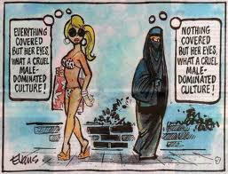
Symbolic-Interactionist Theory
Depending on your perspective, worldview, identity, experiences, etc., your interpretation of a person/place/situation is often different from others with different experiences, etc.

Slide 50
Symbolic-Interactionist Theory
Questions to discuss?
  What actions/beliefs, etc. are considered deviant or criminal?
    Does everyone have the same definition of deviance … are things that are criminal inherently wrong? Are there things that are criminal, but not considered deviant?
  Can you think of an example of a belief or behavior that was once seen as deviant that is now seen as normal or generally accepted? (what about something that used to be normative but is now seen as deviant or has been criminalized)
    Why or how have these labels changed over time?
  How may people act differently toward people depending on their status and/or cultural labels?

Slide 51
Symbolic-Interactionist Theory
Recent controversy:
  The confederate flag
    Does everyone share the same meaning behind this symbol?
    This example illustrates the powerful and sometimes divisive nature of symbols in society.
      Symbols are powerful because of the meaning we attach to them

Slide 52
Sociology’s Common Ground
structure
the recurring patterns of behavior and social relations in a group or society
power
the ability to bring about an intended outcome, even when opposed by others
culture
the collection of values, beliefs, knowledge, norms, language, behaviors, and material objects shared by a people and socially transmitted from generation to generation

Slide 53
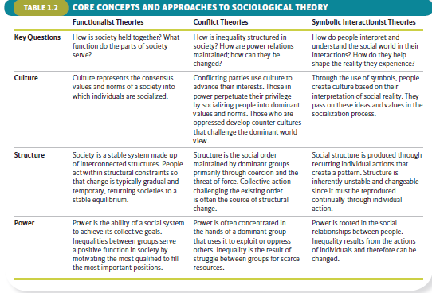
Sociology’s Common Ground

Slide 54
